Slide 1

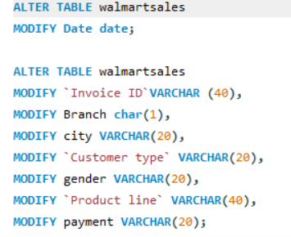
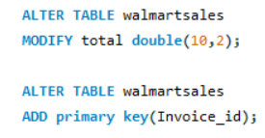
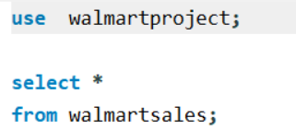
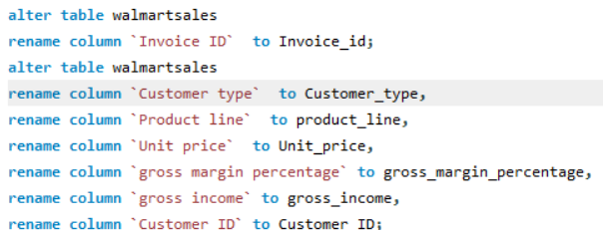
SQL PROJECT
Setting up database and table
Before performing task setting up dataset by altering table to proper data type ,renaming, modifying and setting primary key

Slide 2
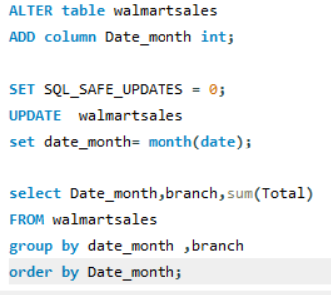
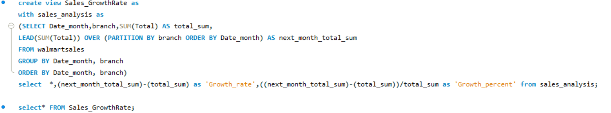
Task 1
Main SQL query and supporting SQL query screenshot

Slide 3
Date_month | branch | total_sum | next_month_total_sum | Growth_rate | Growth_percent
1 | A | 29361.14 | 18359.25 | -11001.89 | -37.47%
1 | B | 26530.77 | 25464.45 | -1066.32 | -4.02%
1 | C | 30670.66 | 19346.04 | -11324.62 | -36.92%
2 | A | 18359.25 | 26869.44 | 8510.19 | 46.35%
2 | B | 25464.45 | 20789.78 | -4674.67 | -18.36%
2 | C | 19346.04 | 25090.03 | 5743.99 | 29.69%
3 | A | 26869.44 | 4574.44 | -22295 | -82.98%
3 | B | 20789.78 | 1746.95 | -19042.83 | -91.60%
3 | C | 25090.03 | 1636.24 | -23453.8 | -93.48%
4 | A | 4574.44 | 3011.62 | -1562.82 | -34.16%
4 | B | 1746.95 | 5016.41 | 3269.46 | 187.15%
4 | C | 1636.24 | 4770.66 | 3134.43 | 191.56%
5 | A | 3011.62 | 2766.49 | -245.13 | -8.14%
5 | B | 5016.41 | 4122.73 | -893.68 | -17.82%
5 | C | 4770.66 | 2723.01 | -2047.66 | -42.92%
6 | A | 2766.49 | 3541.25 | 774.76 | 28.01%
6 | B | 4122.73 | 4363.13 | 240.4 | 5.83%
6 | C | 2723.01 | 3596.33 | 873.33 | 32.07%
7 | A | 3541.25 | 3970.08 | 428.83 | 12.11%
7 | B | 4363.13 | 4056.96 | -306.17 | -7.02%
7 | C | 3596.33 | 5476.74 | 1880.4 | 52.29%
8 | A | 3970.08 | 3580.6 | -389.48 | -9.81%
8 | B | 4056.96 | 4220.13 | 163.17 | 4.02%
8 | C | 5476.74 | 5966.55 | 489.81 | 8.94%
9 | A | 3580.6 | 3233.36 | -347.25 | -9.70%
9 | B | 4220.13 | 2378.22 | -1841.91 | -43.65%
9 | C | 5966.55 | 4253.62 | -1712.93 | -28.71%
10 | A | 3233.36 | 4023.09 | 789.73 | 24.42%
10 | B | 2378.22 | 2331.26 | -46.96 | -1.97%
10 | C | 4253.62 | 3264.02 | -989.6 | -23.27%
11 | A | 4023.09 | 2909.61 | -1113.47 | -27.68%
11 | B | 2331.26 | 5176.89 | 2845.63 | 122.06%
11 | C | 3264.02 | 3774.8 | 510.78 | 15.65%
12 | A | 2909.61 | NULL | NULL | NULL
12 | B | 5176.89 | NULL | NULL | NULL
12 | C | 3774.8 | NULL | NULL | NULL
New column date_month added by setting SQL safe update zero
Sales rate over time per month showing negative trend
this indicate that comparative there is good sales for starting of month than other month
Top Branch by Sales Growth Rate :Branch B (it performing better than other branch in sum growth rate and having high average growth percent that is 12.24%
By running main SQL query of cte and view feature we get above result table which is formatted in excel for visual appealing look
Row Labels | Sum of Growth_rate | Average of Growth_percent
A | -26451.53 | -9.00%
B | -21353.88 | 12.24%
C | -26895.87 | 9.54%
Grand Total | -74701.28 | 0.042578303

Slide 4
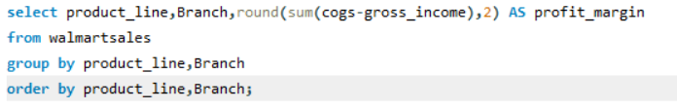
Task 2
product_line | Branch | profit_margin
Electronic accessories | A | 16572.63
Electronic accessories | B | 15427.5
Electronic accessories | C | 17162.41
Fashion accessories | A | 14777.03
Fashion accessories | B | 14850.14
Fashion accessories | C | 19506.73
Food and beverages | A | 15528.52
Food and beverages | B | 13765.85
Food and beverages | C | 21503.34
Health and beauty | A | 11397.97
Health and beauty | B | 18077.74
Health and beauty | C | 15032.91
Home and lifestyle | A | 20282.22
Home and lifestyle | B | 15877.82
Home and lifestyle | C | 12572.17
Sports and travel | A | 17527.68
Sports and travel | B | 18084.56
Sports and travel | C | 14260.79
Row Labels | Sum of profit_margin
Electronic accessories | 49162.54
Fashion accessories | 49133.9
Food and beverages | 50797.71
Health and beauty | 44508.62
Home and lifestyle | 48732.21
Sports and travel | 49873.03
Grand Total | 292208.01
Row Labels | Sum of profit_margin
A | 96086.05
B | 96083.61
C | 100038.35
Grand Total | 292208.01
Most Profitable Product Line for Each Branch is shown as you can see in first table highlighted in yellow
Overall sum of profit margin is highest for food and beverages=50797.71,shown in second figure
Overall sum of profit margin is highest for branch C=100038.35 50797.71,shown in third figure
By running main SQL query we get above result table which is formatted in excel for visual appealing look

Slide 5
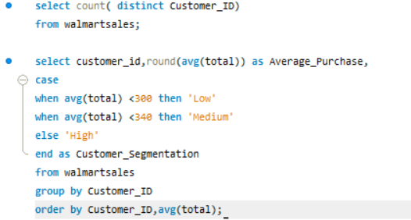
Task 3
customer_id | Average_Purchase | Customer_Segmentation
1 | 338 | Medium
2 | 349 | High
3 | 349 | High
4 | 264 | Low
5 | 293 | Low
6 | 309 | Medium
7 | 308 | Medium
8 | 398 | High
9 | 293 | Low
10 | 309 | Medium
11 | 324 | Medium
12 | 329 | Medium
13 | 319 | Medium
14 | 319 | Medium
15 | 344 | High
Customer segmentation done by running cases SQL queries
By using cases segmented average purchase value of each customer of customer id into high , medium and low
Most of customer are medium range while customer_id = 1 is highest while customer_id = 4 is lowest
By running main SQL query we get above result table which is formatted in excel for visual appealing look

Slide 6
Task 4
This chart is based upon table which created by running SQL queries
Both query and table screenshot mention in next slide
This chart is showing Anomalies in Sales Transactions , as you can see point which are much far away from average product line sales in both negative and positive direction

Slide 7
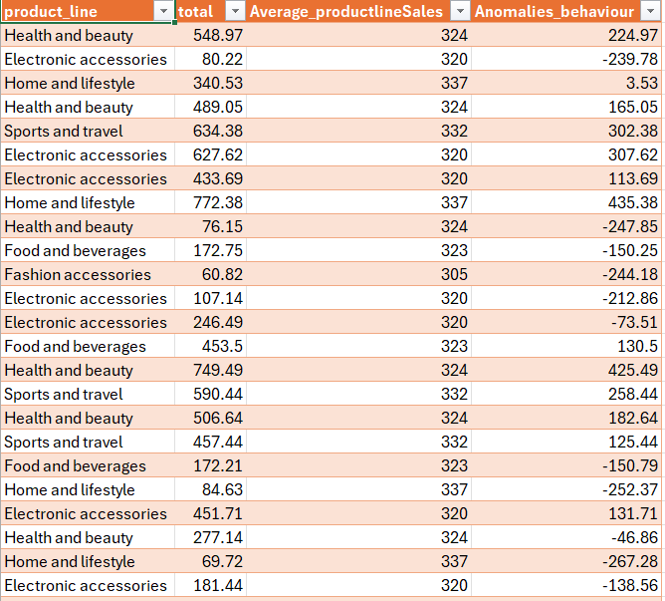
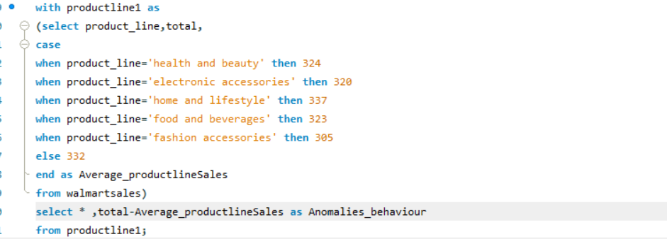

Positive Anomalies Count | 98
Negative Anomalies Count | 253
Positive anomalies count=anomalies behaviour above 400
Negative anomalies count= anomalies behaviour below
-200
By running main SQL query excel formatting we get above result table but it has large amount of rows so only screenshot of initial part of table

Slide 8
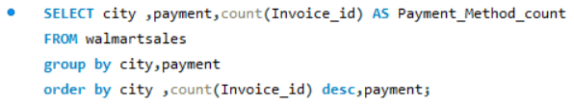
Task 5
City | Payment | Payment_Method_count
Mandalay | Ewallet | 113
Mandalay | Cash | 110
Mandalay | Credit card | 109
Naypyitaw | Cash | 124
Naypyitaw | Ewallet | 106
Naypyitaw | Credit card | 98
Yangon | Ewallet | 126
Yangon | Cash | 110
Yangon | Credit card | 104
most popular payment method in each city is Find by running mention query
By running SQL query we get table which is formatted in excel for visual appealing look as given
most popular payment method in each highlighted in yellow

Slide 9
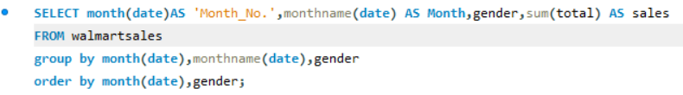
Task 6
Sales Distribution | gender
Month | Female | Male
January | 50.40% | 49.60%
February | 61.31% | 38.69%
March | 41.93% | 58.07%
April | 69.00% | 31.00%
May | 71.82% | 28.18%
June | 34.23% | 65.77%
July | 46.16% | 53.84%
August | 72.54% | 27.46%
September | 46.59% | 53.41%
October | 55.07% | 44.93%
November | 58.16% | 41.84%
December | 37.98% | 62.02%
Sales Distribution | gender
Month | Female | Male
January | 43624.7 | 42937.87
February | 38729.91 | 24439.83
March | 30503.92 | 42245.33
April | 5491 | 2466.63
May | 9191.71 | 3606.98
June | 3290.25 | 6321.98
July | 5308.93 | 6191.79
August | 9795.38 | 3708.4
September | 6414.48 | 7352.8
October | 5433.13 | 4432.07
November | 5594.36 | 4024.01
December | 4505.17 | 7356.13
Grand Total | 167882.94 | 155083.82
Query to sales distribution between male and female customers on a monthly basis and formatted table by using pivot feature in excel is shown
For overall and also on monthly basis sales distribution for female is high than males

Slide 10
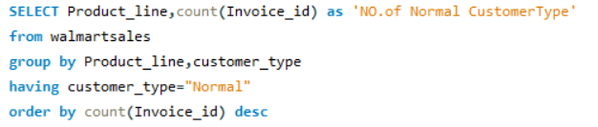
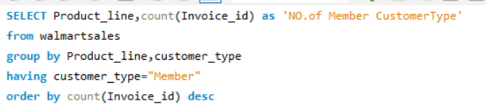
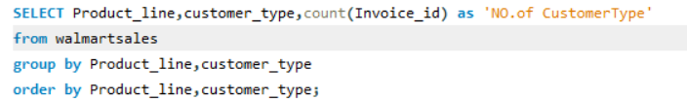
Task 7
Product_line | NO.of Normal CustomerType
Electronic accessories | 92
Fashion accessories | 92
Food and beverages | 80
Sports and travel | 79
Health and beauty | 79
Home and lifestyle | 77
Product_line | NO.of Member CustomerType
Food and beverages | 94
Sports and travel | 87
Fashion accessories | 86
Home and lifestyle | 83
Electronic accessories | 78
Health and beauty | 73
SQL query to run which product lines are preferred by different customer types and their respective chart with formatting in excel shown
electronic accessories and fashion accessories are preferred by normal customer
While food and beverages are preferred by member product line

Slide 11
Product_line | customer_type | NO.of CustomerType
Electronic accessories | Member | 78
Electronic accessories | Normal | 92
Fashion accessories | Member | 86
Fashion accessories | Normal | 92
Food and beverages | Member | 94
Food and beverages | Normal | 80
Health and beauty | Member | 73
Health and beauty | Normal | 79
Home and lifestyle | Member | 83
Home and lifestyle | Normal | 77
Sports and travel | Member | 87
Sports and travel | Normal | 79
Both member and normal customer distribution productline and there graphical comparative percentage chart shown

Slide 12
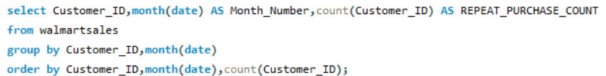
Task 8
Adjacent Table showing repeat purchase of customer by using there ID for each month
As you can see there is high repeat order for first three month(that is January, February , march)
NA showing there is no order for that customer id in that month
April and November has least orders while January has highest orders
SQL query to perform task
SUM OF REPEAT_PURCHASE_COUNT | MONTH_NUMBER
Customer_ID | 1 | 2 | 3 | 4 | 5 | 6 | 7 | 8 | 9 | 10 | 11 | 12 | Total Order by Customer_id'
1 | 17 | 12 | 12 | 2 | 6 | 4 | 1 | 2 | 3 | 3 | 1 | 4 | 67
2 | 20 | 13 | 16 | 2 | 4 | 1 | 4 | NA | 3 | 2 | 1 | 1 | 67
3 | 18 | 16 | 19 | 1 | 1 | 1 | 1 | 1 | 1 | 2 | 3 | 3 | 67
4 | 17 | 18 | 17 | NA | 2 | NA | 1 | 5 | NA | 1 | 4 | 2 | 67
5 | 12 | 14 | 18 | 1 | 3 | 4 | 4 | 4 | 2 | 3 | 1 | 1 | 67
6 | 15 | 14 | 13 | 3 | 5 | 2 | 3 | 3 | 3 | 2 | 1 | 3 | 67
7 | 18 | 13 | 12 | 3 | 3 | 3 | 2 | 3 | 2 | 3 | 3 | 2 | 67
8 | 19 | 13 | 15 | NA | 1 | 2 | 6 | 1 | 3 | 2 | 1 | 4 | 67
9 | 15 | 9 | 18 | 3 | 3 | 4 | 3 | 4 | 2 | 3 | 2 | 1 | 67
10 | 20 | 16 | 9 | 1 | 2 | 2 | 4 | 3 | 3 | 2 | 5 | NA | 67
11 | 24 | 14 | 17 | 4 | 2 | 1 | 2 | 2 | NA | NA | NA | NA | 66
12 | 12 | 8 | 20 | 2 | 2 | 2 | 4 | 2 | 6 | 5 | 1 | 2 | 66
13 | 20 | 14 | 9 | 3 | 4 | 2 | 1 | 3 | 4 | NA | 2 | 4 | 66
14 | 19 | 12 | 18 | NA | 2 | 4 | 2 | 5 | 2 | 2 | NA | NA | 66
15 | 16 | 15 | 15 | 4 | 1 | 1 | NA | 3 | 3 | 2 | 2 | 4 | 66
Total Order by Month | 262 | 201 | 228 | 29 | 41 | 33 | 38 | 41 | 37 | 32 | 27 | 31 | 1000
table creation by running sql query and using excel pivot and formatting for better summarization

Slide 13
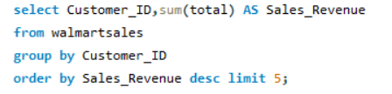
Task 9
Top 5 Customers by Sales Volume
Customer_ID | Sales_Revenue
8 | 26634.34
3 | 23402.26
2 | 23392.28
15 | 22674.46
1 | 22634.55
By running SQL query we get table of top 5 customers who have generated most sales Revenue which is formatted in excel for visual appealing look

Slide 14
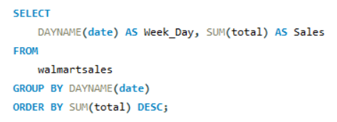
Task 10
Week_Day | Sales
Tuesday | 54630.22
Sunday | 49704.6
Wednesday | 47221.21
Saturday | 46842.79
Thursday | 45166.16
Friday | 44352.87
Monday | 35048.91
By running SQL query we get table of which day of the week brings the highest sales which is formatted in excel for visual appealing look
Tuesday brings highest sales which is highlighted
Also query is arranged well by using beutify feature in SQL

Slide 15
PROJECT SUGGESTION
Finding reason of negative growth rate over time per month in year and work on it If there is space for improvement
Finding reason and get learning from branch B for better growth rate
Focus on product line contributes the highest profit to each branch and analyzing for extra potential growth and also analyze growth potential of other less performing branch to improve profit margin on it
Developing policy to attract high purchase rate customer in such way it maintain and beneficial for medium purchase rate customer
Removing anomalies from data for better analysis and to solve business problem
Develop offer related payment method as per popular payment method for each city
Provide offer specifically for female gender and especially in month when female sales high
Create policy in male high sale month to attract male customer in other month to improve overall male customer sales
Providing discount to normal customer in food and beverages product line so they come regularly for purchasing food and beverages and become regular customer
Provide offer to member customer to maintain them and attract normal customer by looking offers provided to member customer
For first three month there are high repeat orders so focus on applying different customer beneficial policy for these three month for overall improvement in business
Providing goodies to the top five customer by sales and focus on Tuesday which is market day giving high sale compare to other day

Slide 16
Video Submission
Loom video link
https://www.loom.com/share/ee000d2ac12446ec81134f676e03ef27?sid=c301bfe1-1ce3-4ae9-9e11-83b91faa846a
OR
Google drive link(screen recording of loom video)
https://drive.google.com/file/d/1WUHYAXc1qr7K0ahu3r4-Rb62TmcwTITw/view?usp=sharing

